Slide 1
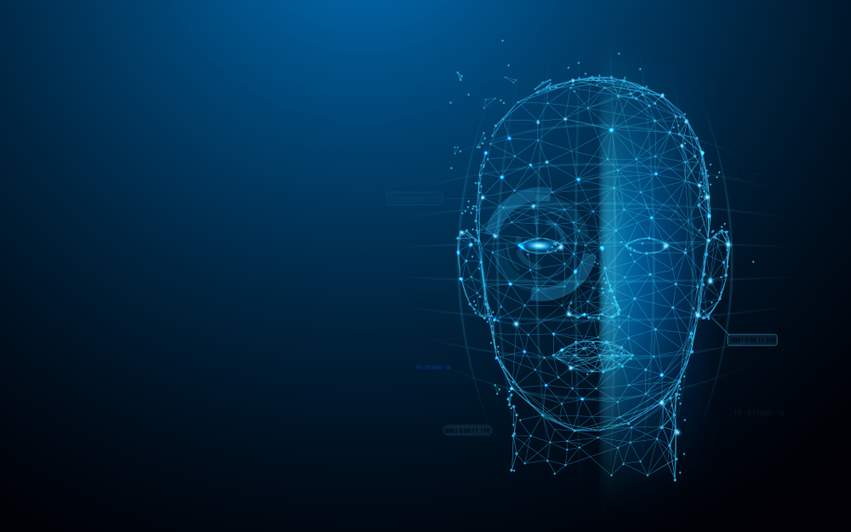

Contactless attendance system

Slide 2
Team details
Team name – code maniacs
Team members:
1. Neel Shah | neelcshah1012@gmail.com
L J Institute of Engineering and Technology
2. Dhruv Panchal | L J Institute of Engineering and Technology
3. Nirja Desai | L J Institute of Engineering and Technology
4. Urveshkumar Patel | L J Institute of Engineering and Technology
5. Payal Devalia | OM Engineering College

Slide 3
Problem definition
NAME: CONTACTLESS ATTENDANCE SYSTEM
Every organization has either a card punching attendance system or bio metric attendance system where it takes a bit longer when all employees gather to punch at the reporting time. In COVID times it is really difficult to keep up with hygiene for the attendance system as all people touch the same surface. So it is really important to have a safety measure where it saves our time too. Why don't we have a contactless attendance system where your face is identified for attendance.

Slide 4
aBSTRACT
Uniqueness or individuality of an individual face is the representation of one’s identity. In this project, face of an individual is used for the purpose of making attendance system automatically.
Attendance of the employee is very important for every organization. Conventional methodology of taking attendance is by RFID card system, Fingerprint system, Voice recognition system. But it is easy an employee to manipulate. To stay away from these losses, an automatic process is used in this project which is based on image processing.
In this project face detection and face recognition is used. Face detection is used to locate the position of face region and face recognition is used for marking the understudy’s attendance.
The database of all the employee in the company is stored and when the face of the individual employee matches with one of the faces stored in the database then the attendance is recorded with precise time of entry.

Slide 5
What is face detection?
Face detection is a type of computer vision technology that is able to identify people’s faces within digital images.
Face detection is the process of identifying and locating all the present faces in a single image or video regardless of their position, scale, orientation, age and expression.
Furthermore, the detection should be irrespective of extraneous illumination conditions and the image and video content.

Slide 6
What is face recognition?
Face recognition is a visual pattern recognition problem, where the face, is represented as a three dimensional object that is subject to varying illumination, pose and other factors, needs to be identified based on acquired images.
Face recognition is therefore simply the task of identifying an already detected face as a known or unknown face and in more advanced cases telling exactly whose face it is.

Slide 7
Aims and objectives
The objective of this project is to develop face recognition attendance system. Expected achievements in order to fulfill the objectives are:
To detect the face segment from the video frame.
To extract the useful features from the face detected.
To classify the features in order to recognize the face detected.
To record the attendance of the identified employee.

Slide 8
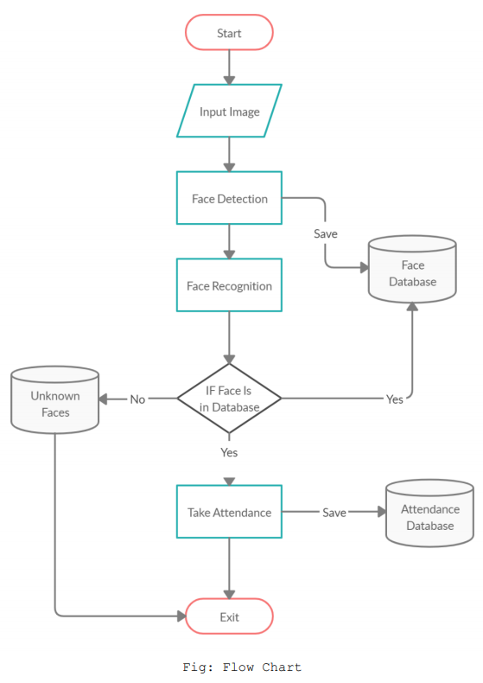
Flow chart

Slide 9
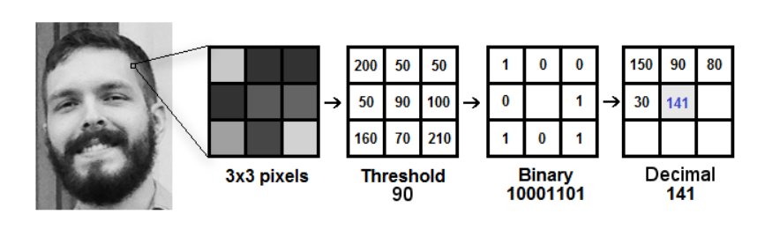
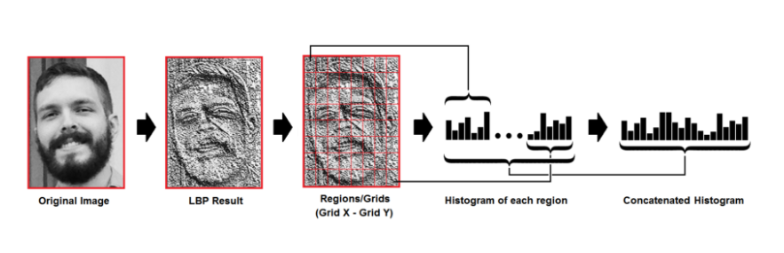
Local binary patterns histogram
Local binary pattern (LBP) is a simple yet very efficient texture operator which labels the pixels of an image by thresholding the neighborhood of each pixel and considers the result as a binary number.
LBPH algorithm work in 5 steps:
Parameters: The LBPH uses 4 parameters namely, Radius, Neighbors, Grid X and Grid Y.
Training the algorithm
Applying the LBP operation
Extracting the Histograms
Performing the face recognition

Slide 10
Features and drawbacks
FEATURES:
This system stores the faces that are detected and automatically marks attendance.
Easy to use as it manipulates and recognizes the faces in real time.
Multipurpose software, as it can be used in different places for different purposes.
DRAWBACKS:
The accuracy of this system is not 100%. It can only detect face from a limited distance.

Slide 11
Result analysis
We have worked on more than 1200 pictures and it has resulted in approximately 70-75% of accuracy.

Slide 12
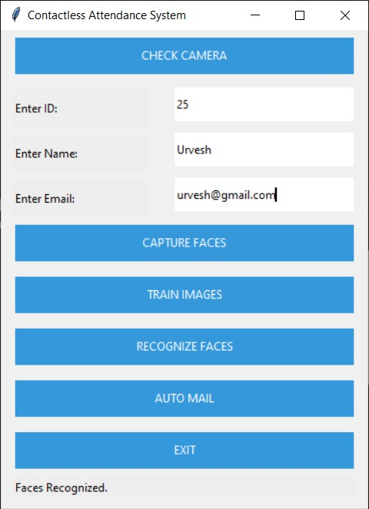
interface
Contactless attendance system

Slide 13
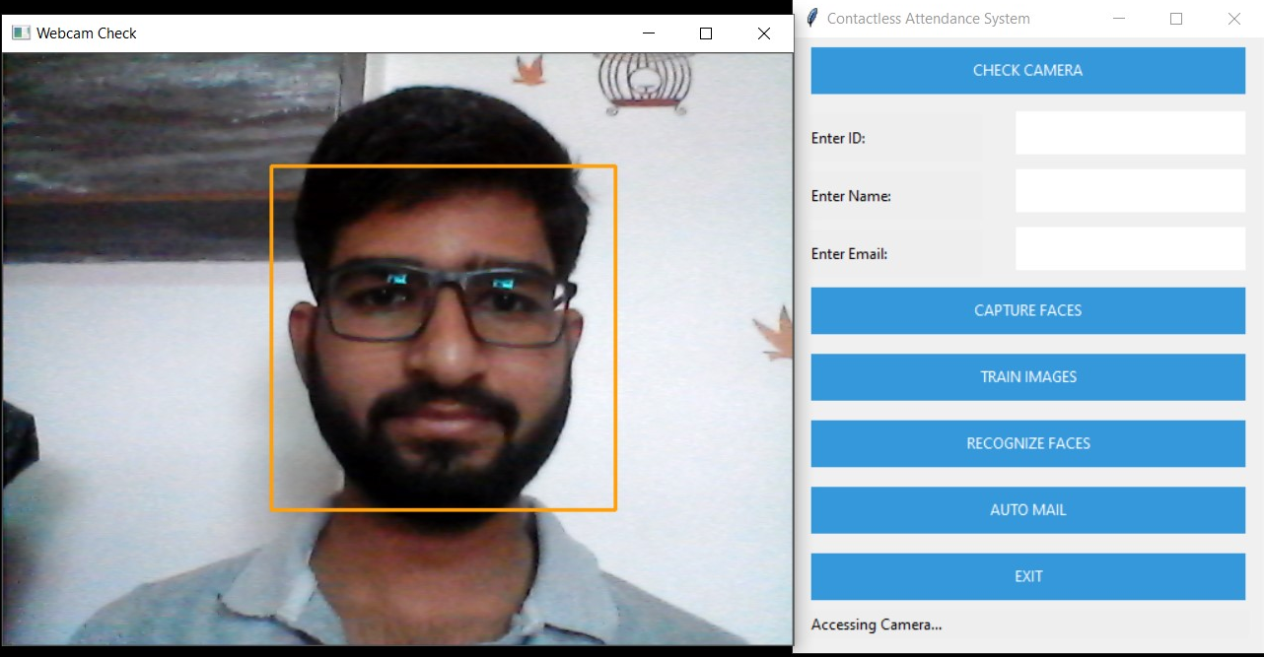
interface
Capturing Faces

Slide 14
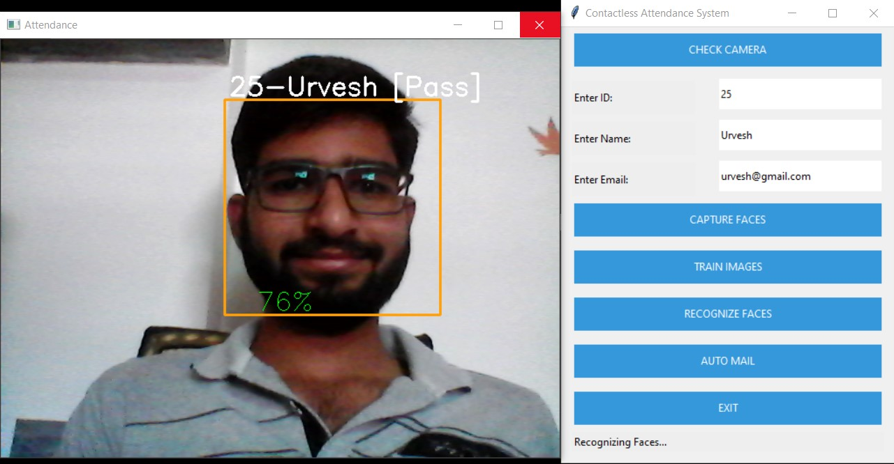
interface
Recognizing Faces

Slide 15
Future Scope of work
Can improve security.
Can use Neural Network for high accuracy
Can be used in big factory or for student attendance.
Can build on fully web base system.

Slide 16
References
https://towardsdatascience.com/face-recognition-how-lbph-works-90ec258c3d6bhttps://docs.opencv.org/3.4/d2/d99/tutorial_js_face_detection.html
https://pypi.org/project/yagmail/
https://www.tutorialspoint.com/python/python_gui_programming.htm#:~:text=Tkinter%20is%20the%20standard%20GUI,to%20the%20Tk%20GUI%20toolkit.&text=Import%20the%20Tkinter%20module
https://docs.python.org/3/library/tkinter.html
https://pandas.pydata.org/
https://bpspsychub.onlinelibrary.wiley.com/doi/abs/10.1111/j.2044-8295.1986.tb02199.x
https://machinelearningmastery.com/

